Slide 1


HOTEL RECOMMENDATION SYSTEM
PRESENTED BY
Soham Mahajan (112003139)
Vinayak Sonawane (112003141)
Ganesh Wankhade (112003153)
Personalized hotel suggestions based on user preferences.

Slide 2


INTRODUCTION
A hotel recommendation system is a type of web application that utilizes algorithms and user data to suggest hotels to users based on their preferences, budget, and other factors.
The system may be used by travelers to find the best hotels for their needs, as well as by hotels to recommend properties to potential guests. Hotel recommendation systems work by gathering information about a user's preferences and requirements, such as the desired location, budget, room type etc.
This data is then used to search for a hotels, and the system suggests the most relevant and suitable options to the user.

Slide 3


PROJECT OBJECTIVES
Improve Customer Satisfaction
The primary objective of a hotel recommendation system is to provide personalized recommendations to customers that match their preferences, interests, and budget, leading to increased customer satisfaction.
Increase Hotel Occupancy
A hotel recommendation system aims to increase hotel occupancy by recommending suitable accommodations to customers that meet their requirements, ultimately leading to increased revenue for the hotel.
Enhance Customer Experience
By providing personalized recommendations, hotel recommendation systems can enhance the customer experience and make it easier for customers to find the right hotel for their needs, leading to increased customer loyalty.

Slide 4

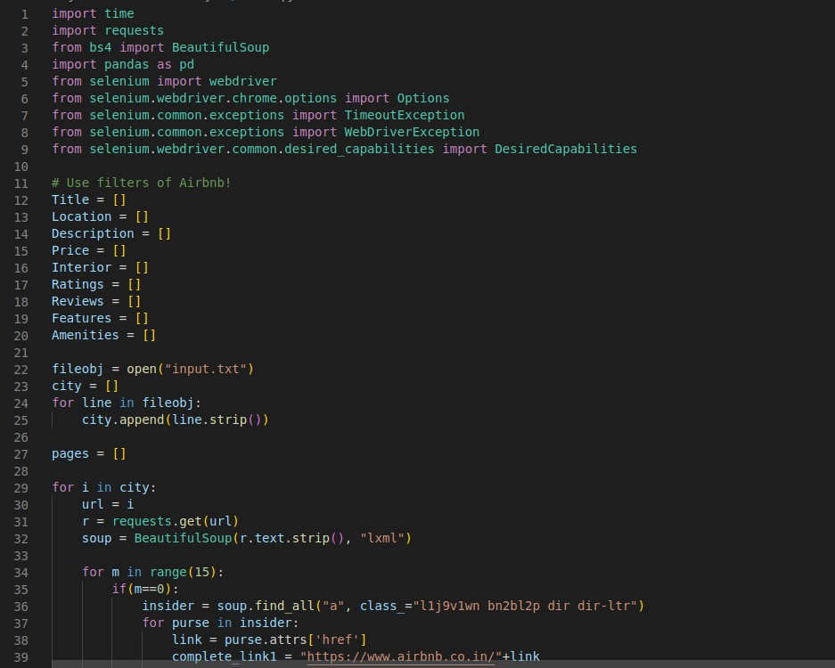

STEPS FOLLOWED
Data Collection
First of all, we have scraped data from Airbnb website. For that we have used web scraping techniques like Beautiful Soup and Selenium to extract the necessary data and features from Airbnb website. We have data of some famous city hotels all around the world.

Slide 5

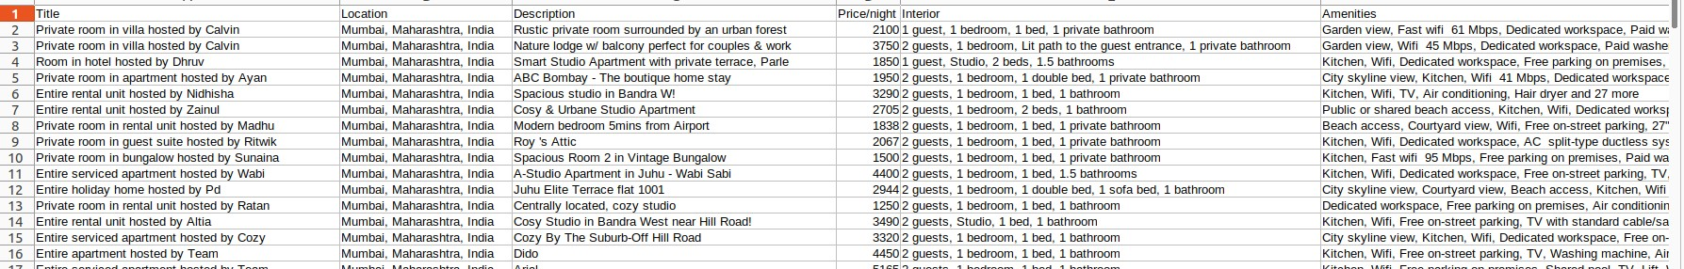
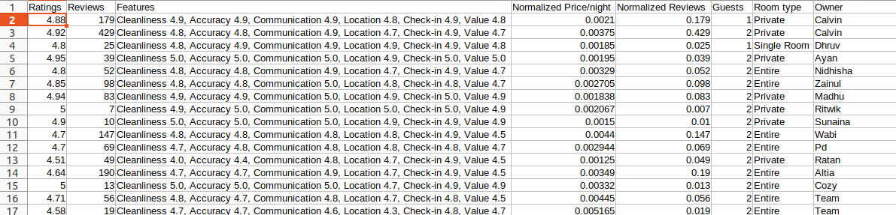

Collected data

Slide 6

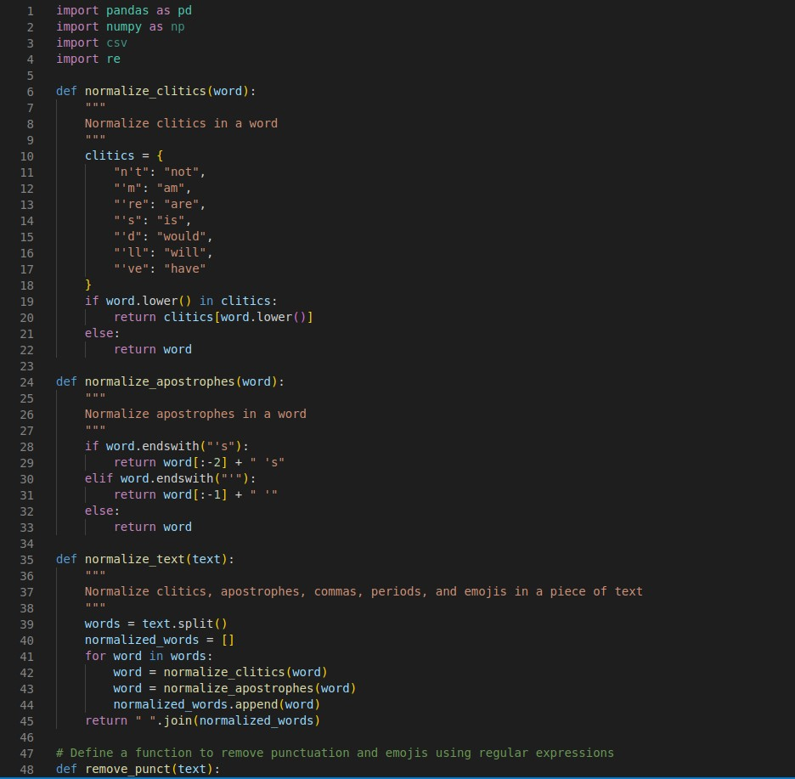


Data Cleaning and Preprocessing
Once we got the data, we cleaned and normalized it. This includes removing duplicates, removing punctuation, handling clitics, Normalization and scaling.
Next, we did the the data preprocessing. This involved standardizing the data, handling missing values, and encoding categorical variables.

Slide 7

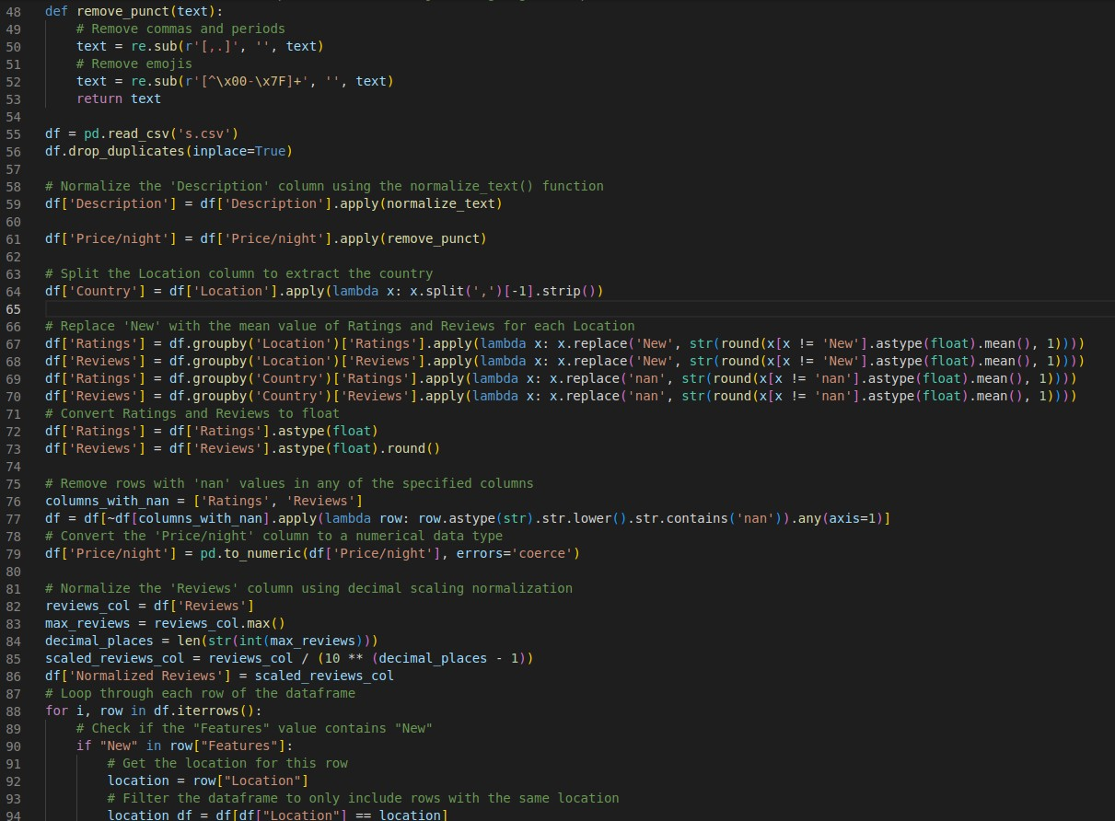


Slide 8

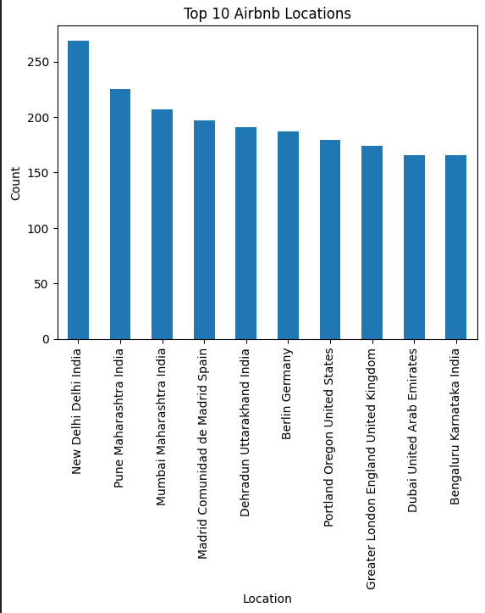

Exploratory Data Analysis (EDA):
We performed exploratory data analysis to visualize the data using various graphs to better understand the data distribution and identify patterns.

Slide 9

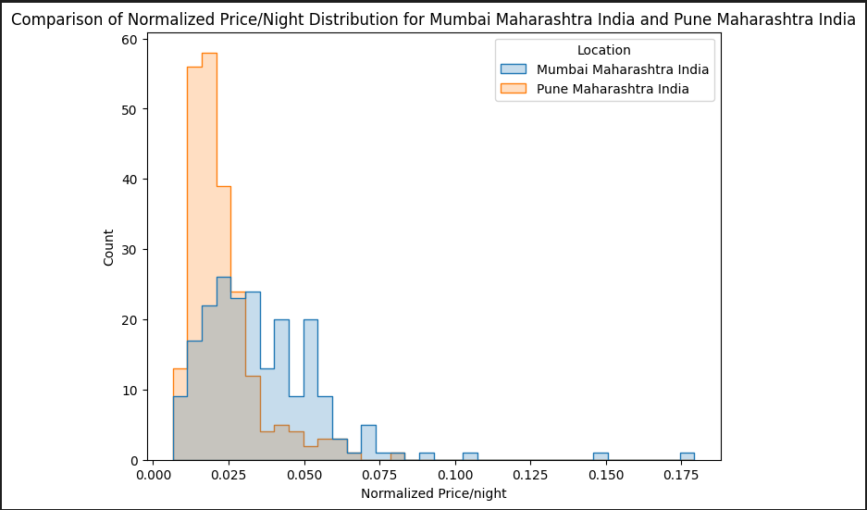
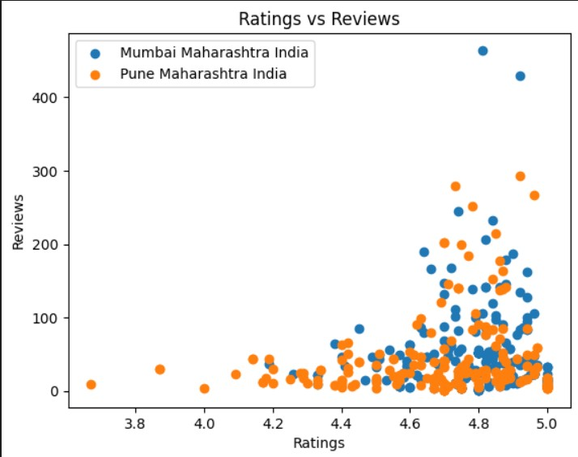


Slide 10
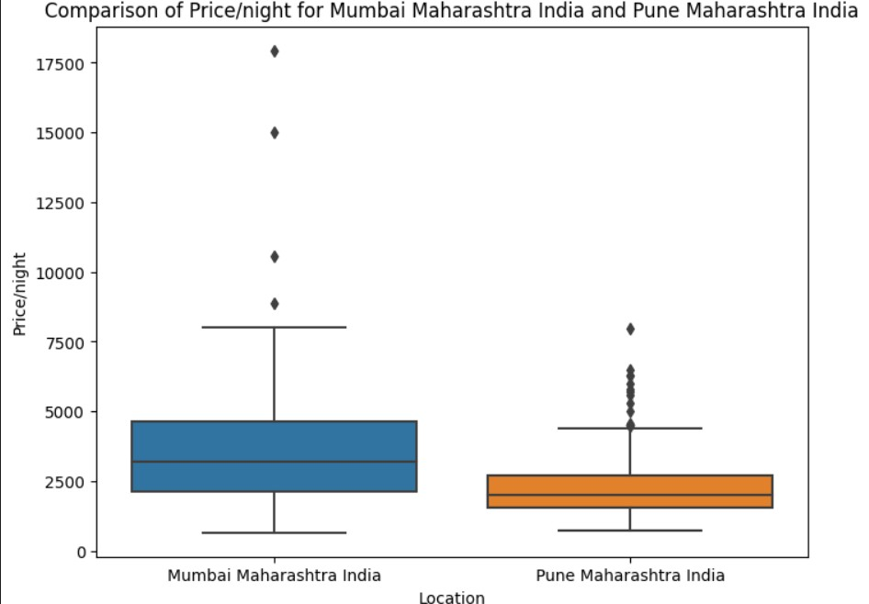

Slide 11


Feature Extraction
For providing more in depth accuracy and more filtering as in point of view for user, we have extracted some of the key features which most users use while choosing a hotel for themselves.
Building the Model
Next, We have build a recommendation model using content-based filtering with cosine similarity. This model will take inputs from the user such as location, price range, and room type, and recommend hotels that match the user's input.

Slide 12
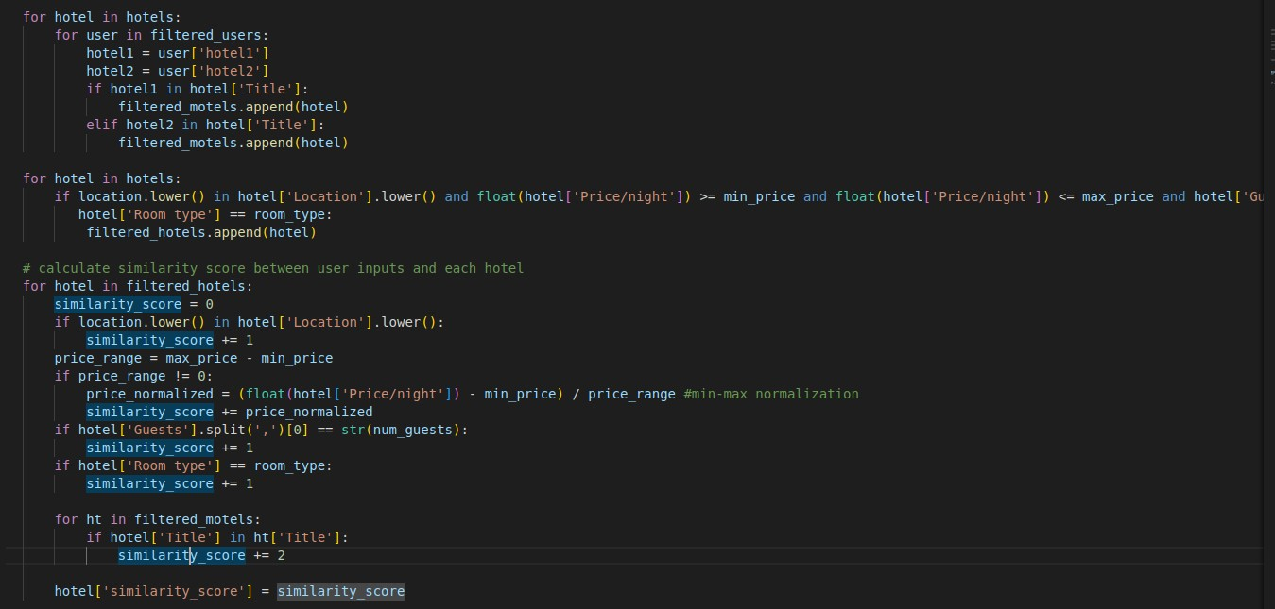

Slide 13


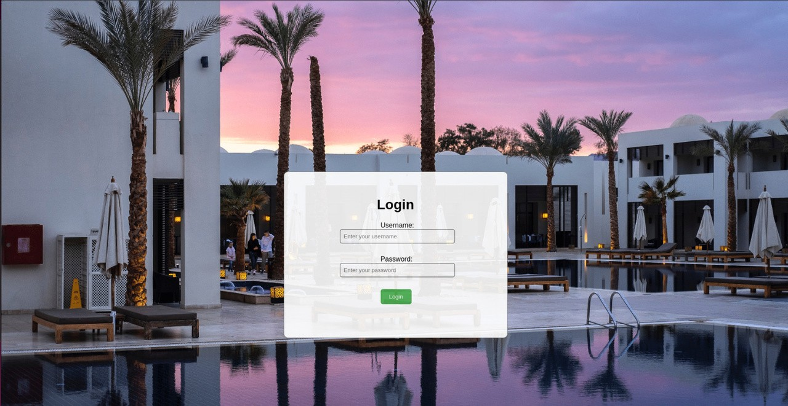

Developing the User Interface
We used web development technologies like HTML, CSS, and Flask to create a user interface that connects to the server side. The user interface should allow users to enter their preferences and display the recommended hotels.

Slide 14
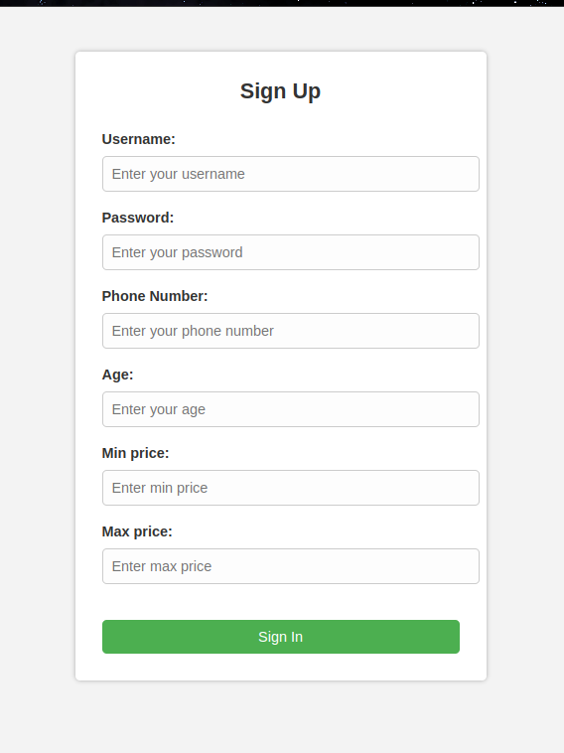
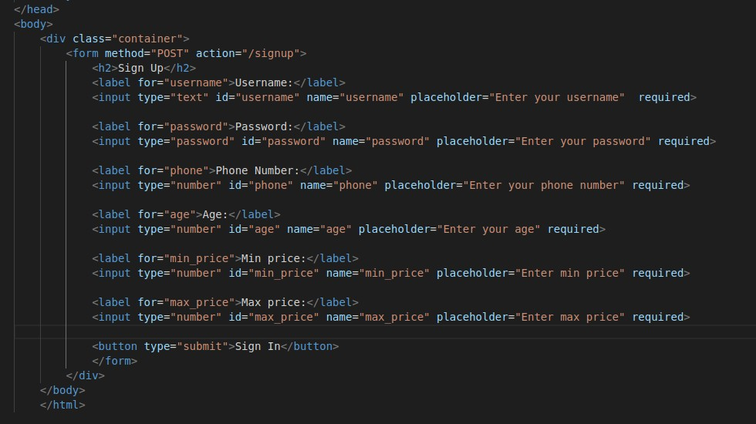

Slide 15
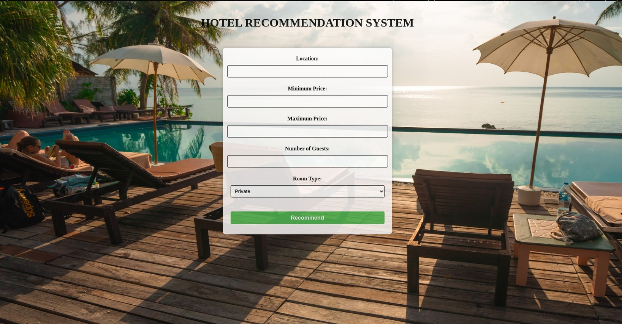

Slide 16
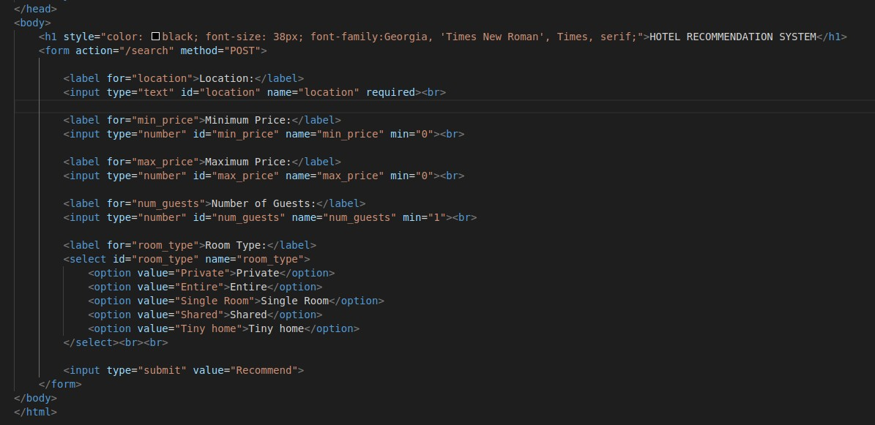

Slide 17

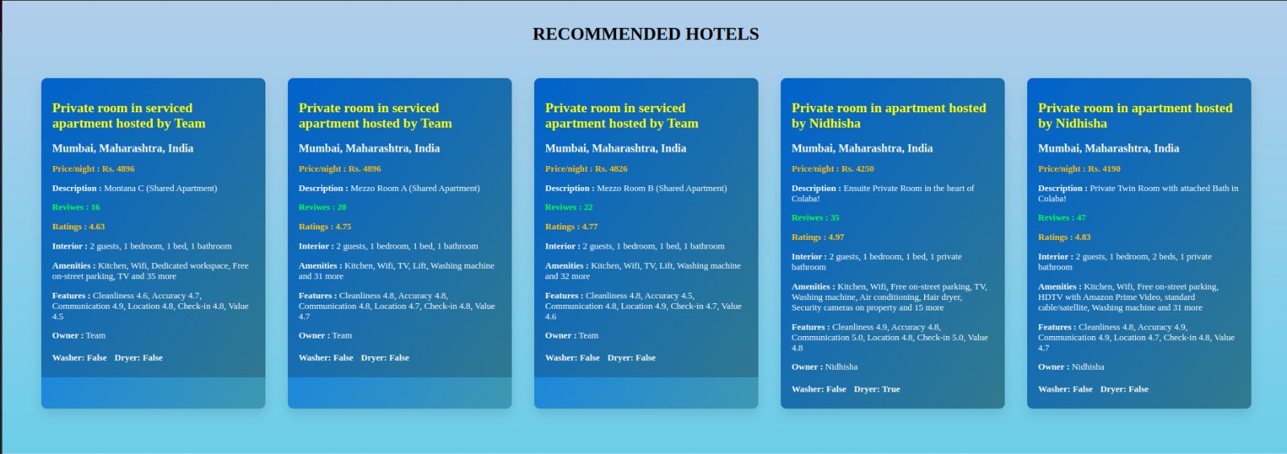


Slide 18


Thank You...

